Slide 1
Airplane Seating Program
Created By:
Greg, Jacolgan, Brandon, Judy, Shenyo’a, & Mark
COIN 235 - C++ Programming
December 6, 2011

Slide 2
Purpose
The purpose of this program is for the user to select a seat(s) for a commercial airplane. The airplane has 13 rows, with six seats in each row. Rows 1 and 2 are first class, rows 3 through 7 are business class, and rows 8 through 13 are economy class. After the user has selected their choice of seat(s) a seating chart will be displayed. The seating chart will display all seats available and reserved including the choices they have selected.

Slide 3
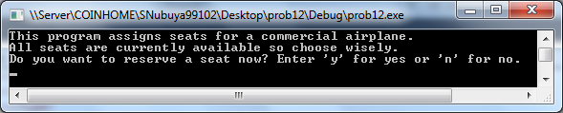
Example Run:
This program is going to prompt the user to enter the following information:
Figure 1.1

Slide 4
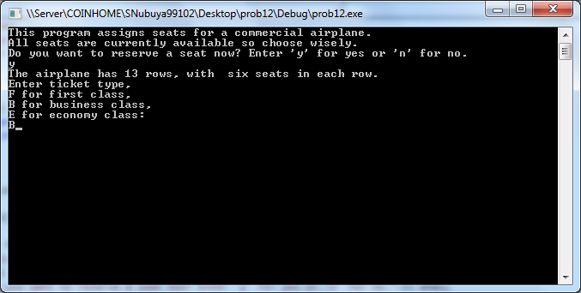
Example Run (continued):
Then the user is asked to pick a ticket type from the following selections:
First class, Business class, and Economy class.
Figure 1.2

Slide 5
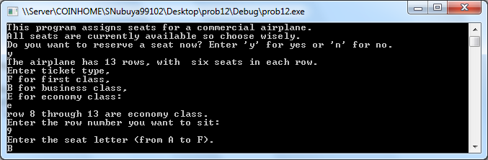
Example Run (continued):
Here the user is given the row number where you would like to sit, followed by the seat letter.
Figure 1.3

Slide 6
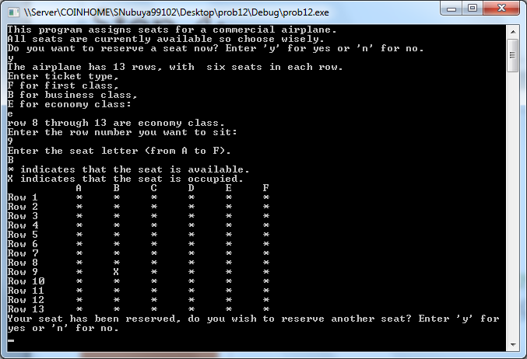
Example Run (continued):
Here the “*” indicates that the seat is available; “X” indicates that the seat is occupied. An that your preference has been reserved.
Figure 1.4

Slide 7
Next Slide
Explanation
of the
Test Plan

Slide 8
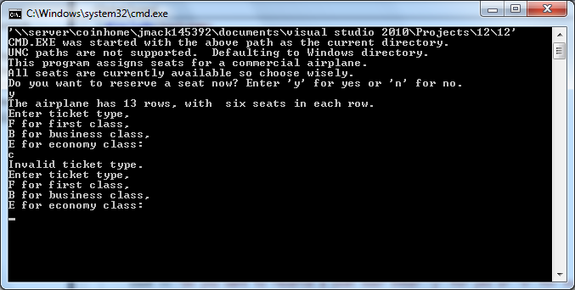
Test Plan
In the screen shot, the user enters the wrong ticket type. The program will alert that you entered an invalid ticket type and ask the user again for the correct ticket type. The code only has tickets for First, Business, and Economy class types.

Slide 9
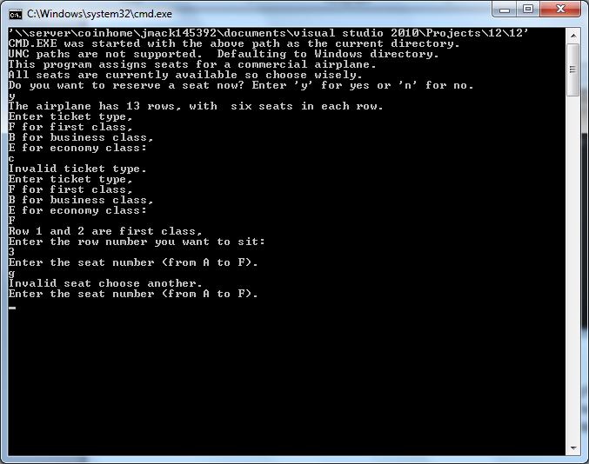
Test Plan (continued)
In this screen shot, the user chooses an invalid row seating number: Row 3 seat number G. An invalid message is presented to the user displaying an invalid seat choice and asks for another selection.

Slide 10
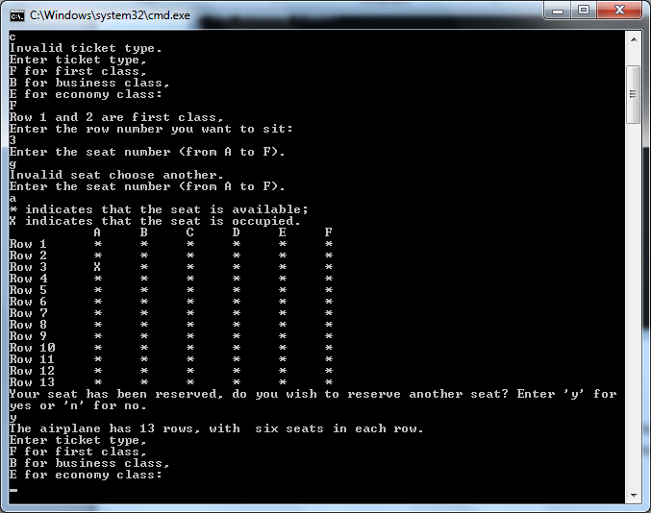
Test Plan (continued)
This screen shot presents the seating chart where the user’s choices are reserved. Row 3 seat A marks an “ X “ in its column is shown above.

Slide 11
Next Slide
Explanation
of the
Airplane Seating Code

Slide 12
Void (initialize, getData, printForm)
Void functions placed in headers are user-defined functions
Syntax:
void initialize( char form[][6]);
void getData(char& ticketType, int& row, char& column);
void printForm(char form[][6], int row, char column);

Slide 13
Initialize Function
The for loop is initializing the Airplane Seating Chart by 13 rows using variable “ i “, and 6 columns using variable “ j “. The asterisk symbol “ * ” is setting the empty array table to all “ * “ until the seating selection is made.
void initialize(char form[][6])
{
for(int i=0;i < 13;i++)
for(int j=0;j<6;j++)
form[i][j]='*';
}

Slide 14
getData Function
void getData(char& ticketType, int& row, char& column)
{
cout << "The airplane has 13 rows, with six seats in each row." << endl;
cout << "Enter ticket type," << endl;
cout << "F for first class, " << endl;
cout << "B for business class," << endl;
cout << "E for economy class:" << endl;
cin >> ticketType;
ticketType = static_cast<char>(toupper(ticketType));
while(ticketType != 'F' && ticketType != 'B' && ticketType != 'E')
{
cout << "Invalid ticket type." << endl;
cout << "Enter ticket type," << endl;
cout << "F for first class, " << endl;
cout << "B for business class," << endl;
cout << "E for economy class:" << endl;
cin >> ticketType;
ticketType = static_cast<char>(toupper(ticketType));
}
The following variables were used to assign ticket types:
F – First class
B – Business class
E – Economy class

Slide 15
printForm Function
void printForm(char form[][6], int row, char column)
{
int i, j;
if(form[row-1][static_cast<int>(column-65)]=='X')
{
cout << "This seat already assigned. Choose another seat: " << endl;
return;
cin >> column;
column = static_cast<char>(toupper(column));
}
form[ row-1 ] [static_cast<int>(column)-65]= 'X';
cout << "* indicates that the seat is available; " << endl;
cout << "X indicates that the seat is occupied. " << endl;
cout << setw(12) << "A" << setw(6) << "B" << setw(6) << "C"
<< setw(6) << "D" << setw(6) << "E" << setw(6) << "F" << endl;
for(i = 0; i < 13; i++)
{
cout << left << setw(3) << "Row " << setw(2)<< i+1;
for(j = 0; j < 6; j++)
{
cout << right << setw(6) << form [i][j];
}
cout << endl;
}
}
The printForm function prints the selected Row 1-13 and Column seats A-F. After the user selects the appropriate seat, an “ X “ is marked on the form.

